Slide 1
MY-BLOG
Presented By:
Sonal Kulkarni

Slide 2
Problem Statement
The My-Blog is an application which offers users to read blogs of various categories. In this, user can also write & create their own blogs and they can also search the blogs by blog title and blogger name .
This is designed for sharing knowledge and thoughts on social platform.

Slide 3
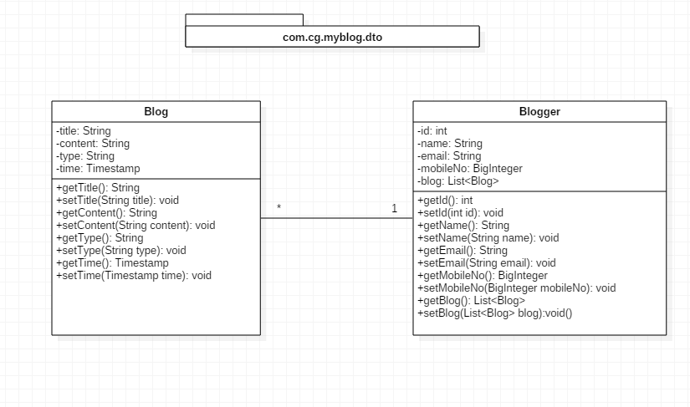
POJO Classes

Slide 4
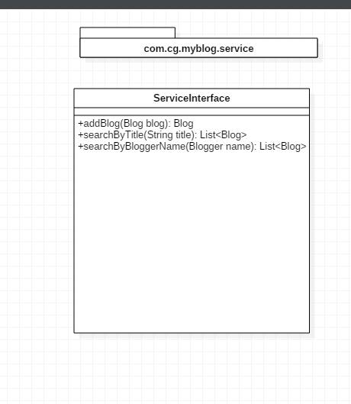
Service Interface

Slide 5
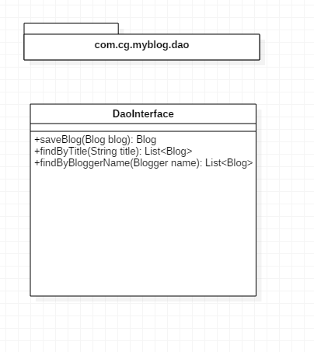
Repository Interface

Slide 6
Thank You

